Slide 1

Welcome to WMSU: Your Admission Guide
Embark on your academic journey with Western Mindanao State University! This guide provides a clear path to becoming a valued member of our community.

Slide 2
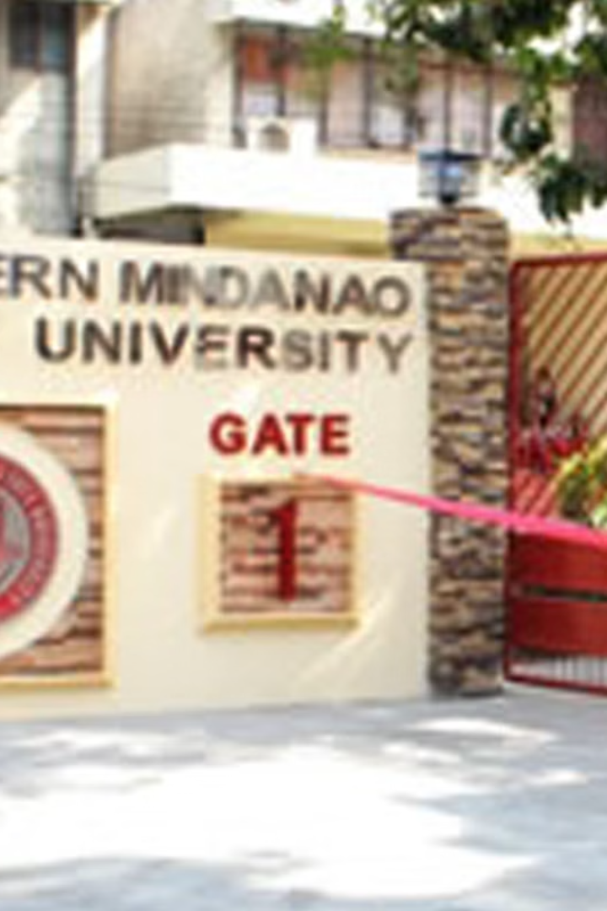



Step 1: Medical Examination Fee
Pay the fee at the WMSU Cashier’s Office, Ground Floor, Administration Building.
Cashier
Pay fees
Where?
Ground Floor Administration Building, WMSU.
Record
Get receipt

Slide 3
Step 2: Physical/Medical Examination
Visit the University Health Center to inquire about requirements and complete your PME.
Inquire
Complete
Certify
About PME requirements.
Medical examination
Secure PME certification.

Slide 4
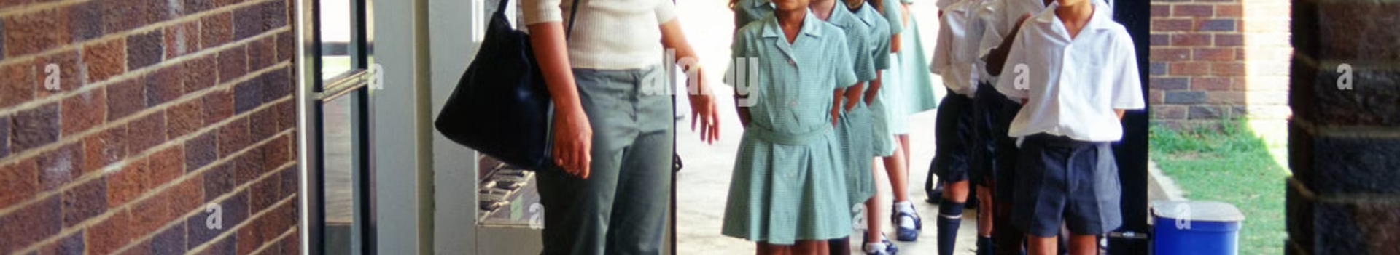
Step 3: College Interview/Enrollment
Proceed to your chosen college on the appointed date for an interview and enrollment.
College Visit
Interview
Enrollment
Go to your chosen college
Attend the interview (if needed)
Enroll on your appointed date

Slide 5




Step 4: Enrollment
Enroll in the college where you qualify.
Requirements
Schedule
Registration
Complete all the requirements
Follow enrollment schedule
Register to your course

Slide 6
What to Bring During Enrollment
Original copy of Form 138/Report Card
Certificate of Good Moral Character
Photocopy of Birth Certificate (PSA)
2x2 ID picture (2 copies)
1
Original Form 138
2
Good Moral
Report Card
Certification
3
Birth Certificate
4
ID Picture
PSA copy
2 copies (2x2)

Slide 7
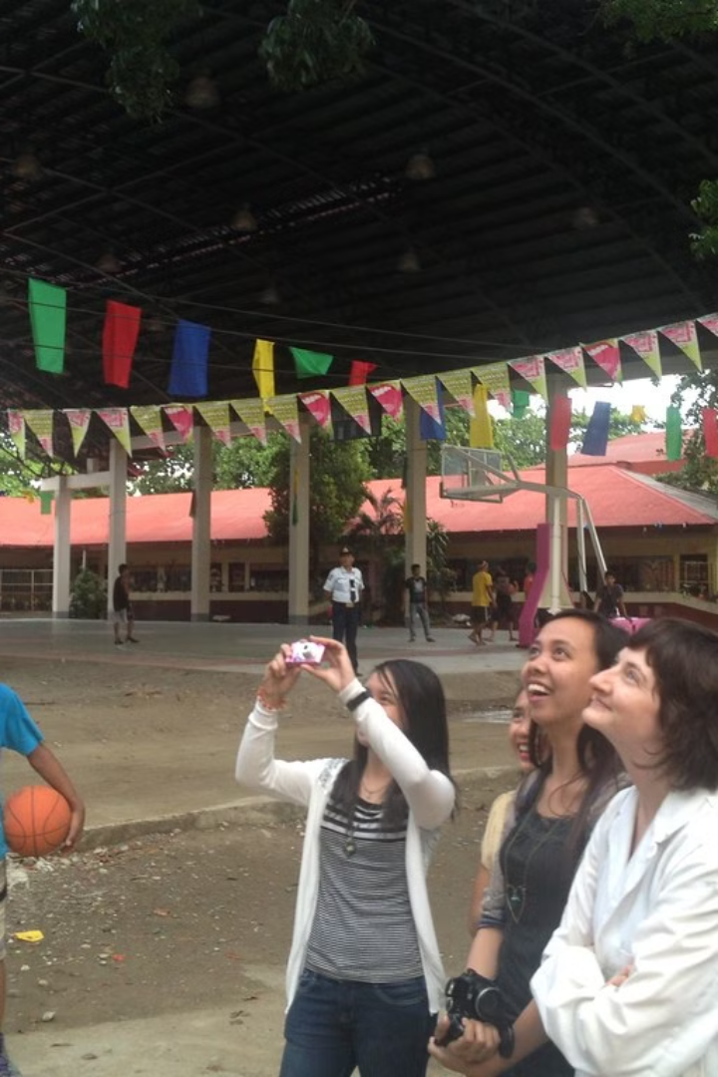
Welcome to WMSU!
We're excited to have you join our academic community. Let's make your dreams a reality!

